Slide 1
Anticipating Coronary Heart Disease Risk using Deep Learning

Slide 2
Abstract
Coronary Heart Disease (CHD) remains a leading cause of mortality worldwide, necessitating early and accurate prediction to improve patient outcomes. This project leverages deep learning techniques to predict CHD risk using the Framingham dataset, a well-established longitudinal study containing key clinical and demographic features. We implement and compare three advanced deep learning models: Artificial Neural Network (ANN), 1D Convolutional Neural Network (CNN), and U-Net architecture, to assess their predictive performance.
The ANN model processes structured risk factors such as age, cholesterol levels, and blood pressure, while the 1D CNN captures temporal and sequential patterns in patient data. The U-Net, traditionally used for image segmentation, is adapted for feature extraction and risk stratification in tabular data. Each model is evaluated based on accuracy, precision, recall, and AUC-ROC metrics to determine their effectiveness in classifying high-risk individuals.
Preliminary results indicate that deep learning models significantly enhance CHD prediction compared to traditional statistical methods. The 1D CNN demonstrates superior performance in handling sequential dependencies, while the U-Net’s skip-connections improve feature learning. This study highlights the potential of deep learning in improving early CHD diagnosis, paving the way for clinical decision-support systems.
Keywords: Coronary Heart Disease, Deep Learning, ANN, 1D CNN, U-Net, Framingham Dataset, Predictive Modeling.

Slide 3
Objective
To develop and compare deep learning models (ANN, 1D CNN, and U-Net) for predicting Coronary Heart Disease (CHD) using the Framingham dataset.
To preprocess and optimize the dataset by handling missing values, normalizing features, and ensuring compatibility with deep learning architectures.
To explore feature importance in CHD prediction by analyzing how different risk factors (e.g., age, cholesterol, blood pressure) contribute to model decisions.
To propose an optimized predictive framework that can assist healthcare professionals in early CHD risk assessment and preventive care.

Slide 4
Data Collection and Description
This dataset is located at Kaggle website.
The dataset contains 16 attributes in all, of which 15 are independent factors and one variable i.e., TenYearCHD is the dependent variable or target variable.
This data set contains total 4240 data. All attributes in data set are numeric.
Demographic:
Sex: male or female (1-male and 0-female)
Age: Age of the patient;(Continuous - Although the recorded ages have been truncated to whole numbers, the concept of age is continuous)
Education: no further information provided

Slide 5
Data Collection and Description
Behavioural:
Current Smoker: whether or not the patient is a current smoker (Nominal)
Cigs Per Day: the number of cigarettes that the person smoked on average in one day (can be considered continuous as one can have any number of cigarettes, even half a cigarette.)
Information on medical history:
BP Meds: whether or not the patient was on blood pressure medication (Nominal)
Prevalent Stroke: whether or not the patient had previously had a stroke (Nominal)
Prevalent Hyp: whether or not the patient was hypertensive (Nominal)
Diabetes: whether or not the patient had diabetes (Nominal)

Slide 6
Data Collection and Description
Information on current medical condition:
Tot Chol: total cholesterol level (Continuous)
Sys BP: systolic blood pressure (Continuous)
Dia BP: diastolic blood pressure (Continuous)
BMI: Body Mass Index (Continuous)
Heart Rate: heart rate (Continuous - In medical research, variables such as heart rate though in fact discrete, yet are considered continuous because of large number of possible values.)
Glucose: glucose level (Continuous)
Target variable to predict:
10year risk of coronary heart disease (CHD) - (binary: “1”, means “Yes”, “0” means “No”)

Slide 7
Attribute Description
Age | (32-70)
Sex | 0=Female, 1=Male
Education | It takes values as: 1=High School, 2=High School or above, 3=College or Vocational School, 4=College
Current Smoker | 0=No 1=Yes
Cigs Per Day | Number of Cigarettes smoked Per Day (0-70)
BP Meds | 0=No 1=Yes
Prevalent Stroke | 0=No 1=Yes

Slide 8
Attribute Description
Prevalent Hyp | 0=No 1=Yes
Diabetes | 0=No 1=Yes
Tot Chol | Serum Cholesterol (107-696) (mg/dl)
Sys BP | (83.5-295) (mm/hg)
Día BP | (48-142.5) (mm/hg)
Body Mass Index | (15.54-56.8)
Heart Rate | Heart Rate achieved (44-143)
Glucose | (40-394) (mg/dl)
10-year CHD | 0=Healthy, 1=Diseases

Slide 9
Software Requirements
Python Packages to be installed
pandas- used to provide fast, flexible and expressive data structures to make working with “relational” or “labeled” data both easy and intuitive.
numpy: To work with arrays
tkinter- used for developing Graphical User Interface (GUI).
sklearn- efficient for data mining and data analysis. It contains a number of algorithms which can be implemented directly when required.
matplotlib- contains modules which are used for plotting graphs.
Seaborn – used for Graphical Presentation
TensorFlow and Karas --- To implement deep learning models

Slide 10
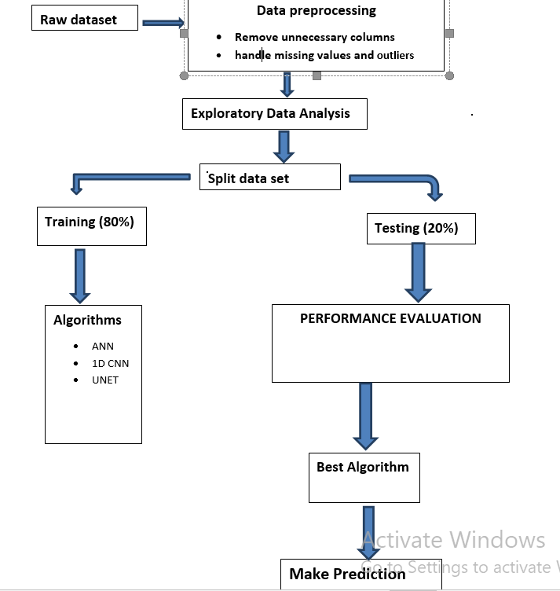
System Architecture Diagram

Slide 11
Data Preprocessing
Data preprocessing is a group of techniques that are applied on the data to improve the quality of the data. Raw data can be converted to useful data. It uses various techniques such as handling missing values, detecting outliers, removing un wanted attributes etc.
Once data is cleaned then it can be used in machine learning models for training. Data preprocessing is one of the most important steps involved in predictive modelling.
Steps followed in data preprocessing
Education column is removed as it has no relation with heart disease
Most corelated features are found by using correlation matrix(heatmap).
Sysbp and Diabp are highly corelated
Current smoker and Cigsperday are highly corelated.so only one of them is selected.
Missing values are handled by imputation .
Outliers found and removed.
Duplicated rows removed.
Features have been standardized by using Standard Scaler .

Slide 12
Exploratory Analysis
Exploratory Data Analysis (EDA) is an approach to analyse the data using visual techniques. It is used to discover trends, patterns, or to check assumptions with the help of statistical summary and graphical representations.

Slide 13
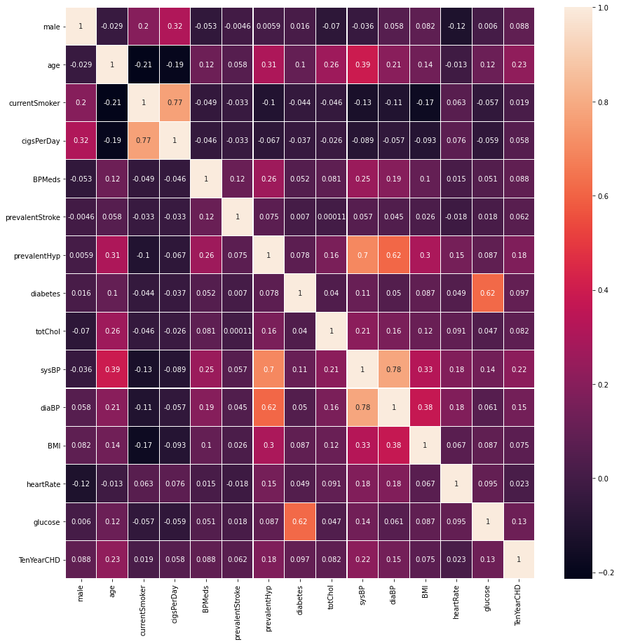
Corelation Matrix

Slide 14
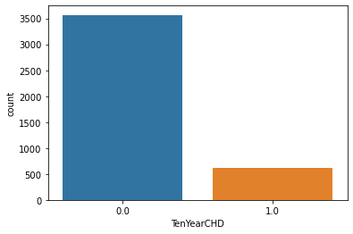
No of people suffer from heart disease and not

Slide 15
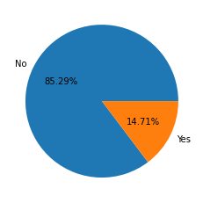
Pie Chart showning percentage of people with and wit out heart disease

Slide 16
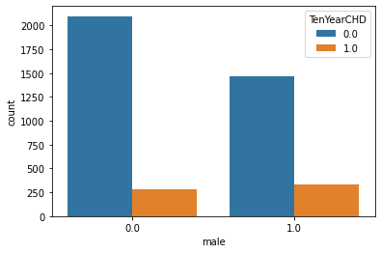
Male and female with and with out disease

Slide 17
Data splitting
Splitting dataset
Data set is splitted into training and testing subsets .
For training 80% data and for testing 20% of data is selected .

Slide 18
Algorithms used
For building deep learning model following algorithms Are used.
ANN
CNN 1D
UNET

Slide 19
ANN
Effective for Non-linear Relationships
  ANNs excel at modeling complex, non-linear interactions between risk factors (e.g., age, cholesterol, blood pressure) that contribute to CHD, outperforming traditional logistic regression.
Handles High-Dimensional Data
  Capable of processing multiple input features simultaneously, making them suitable for datasets like Framingham with numerous clinical and demographic variables.
Feature Learning Without Manual Engineering
  Automatically extracts and weights important features, reducing the need for domain expertise in selecting predictors.

Slide 20
CNN 1D
In this project, a 1D Convolutional Neural Network (CNN) is applied to the structured tabular data from the Framingham dataset to predict the risk of coronary heart disease. Unlike traditional CNNs used for image processing (2D/3D), a 1D CNN processes sequential or feature-aligned data, making it suitable for clinical risk prediction.

Slide 21
UNET
1. U-Net Overview
Originally designed for biomedical image segmentation (e.g., tumors, cells).
Uses an encoder-decoder structure with skip connections to preserve spatial details.
Adapted in this project for structured tabular data (Framingham dataset) to predict CHD risk.
2. How U-Net Works for CHD Prediction
Encoder (Downsampling):
  Compresses input features (e.g., age, cholesterol) into latent representations using convolutional and pooling layers.

Slide 22
In this study, U-Net underperformed ANN, likely due to unnecessary complexity for non-image data.
While U-Net is not optimal for pure tabular data, its structural principles inspire hybrid architectures for future CHD prediction models.

Slide 23
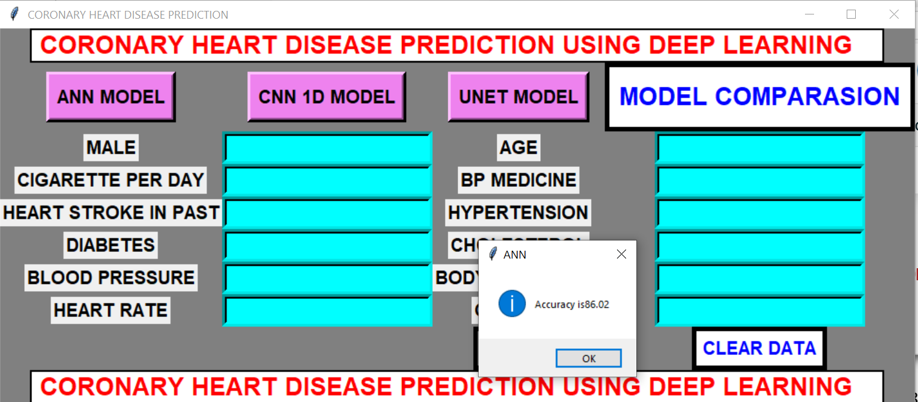
GUI Implementation

Slide 24
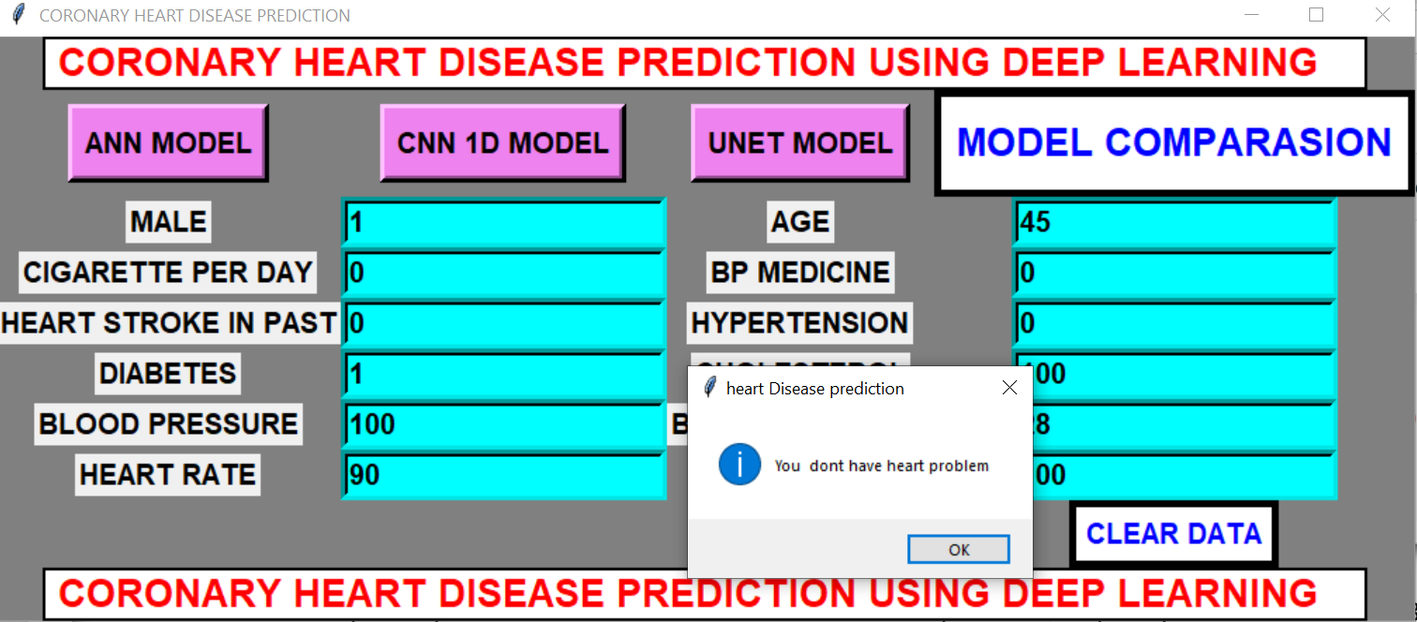
GUI Implementation

Slide 25
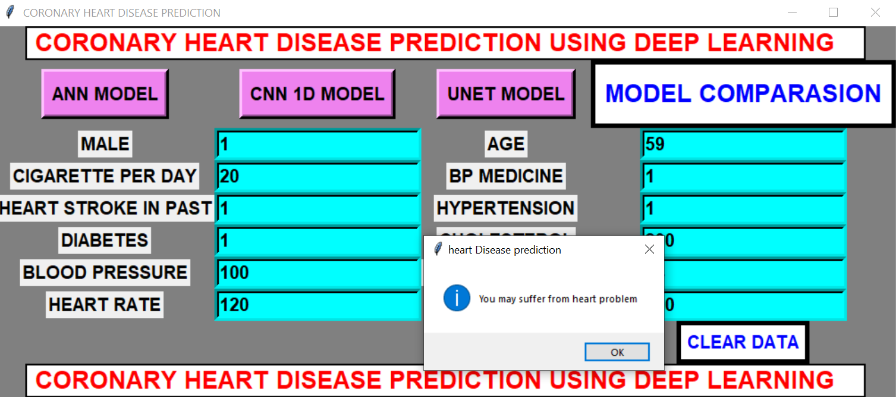
GUI

Slide 26
Conclusion
In this study, we developed and evaluated three deep learning models—Artificial Neural Network (ANN), 1D CNN, and U-Net—for predicting Coronary Heart Disease (CHD) using the Framingham dataset. Among these models, the ANN demonstrated the highest accuracy, outperforming both the 1D CNN and U-Net in classifying individuals at risk of CHD. The superior performance of the ANN can be attributed to its ability to effectively capture complex, non-linear relationships within structured clinical data, such as age, cholesterol levels, and blood pressure.

Slide 27
Future Work
In future a web based system will be developed so that people from different parts of world can use it.

Slide 28
THANKS

